Slide 1
Intelligent Decision Support System for
Drone Selection in Small EU Ports

Slide 2
Title of Project: Intelligent Decision Support System for
Drone Selection in Small EU Ports
Group no.:10
Name of students in the group:
1 Neeraj Bala
2 Ravi Sankar Pakkurthi

Slide 3
Problem Description
Diverse drone management needs
No intelligent support system
Inefficient drone selection
High operational costs
Complex environmental factors

Slide 4
Solution Method for DSS
Define DSS Framework
Identify key components and architecture
Integrate Machine Learning Models
Utilize selected models: Random Forest, SVM, KNN
Data Processing
Clean and preprocess drone and port data
Algorithm Implementation
Implement algorithms in Python using sklearn and keras/tensorflow
System Integration
Combine all components into a cohesive DSS

Slide 5
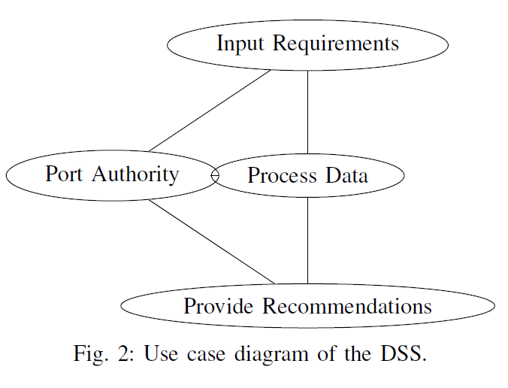
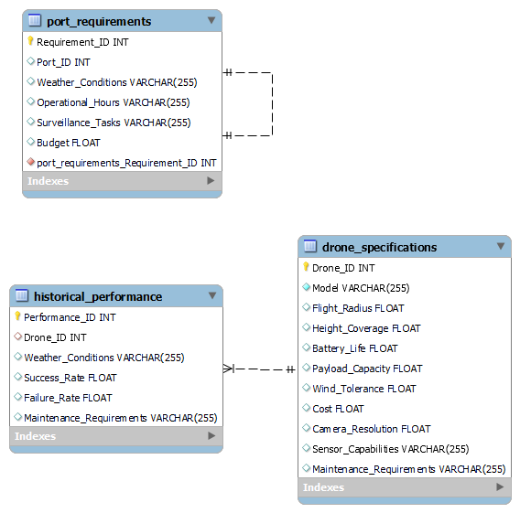
Results

Slide 6
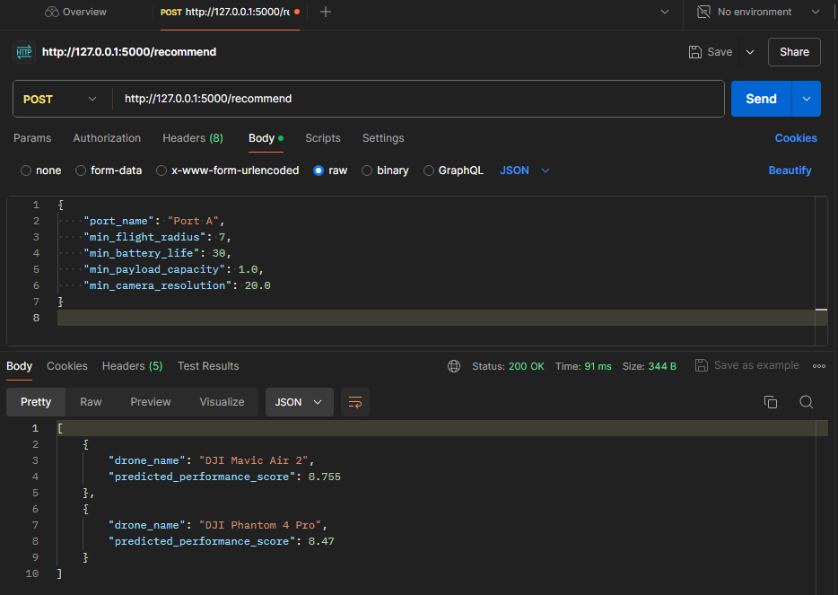
Results

Slide 7
STATUS
Current Progress:
Data collection completed
Initial analysis performed
Preliminary model selected
Prototype of DSS developed
Challenges:
Data quality issues
Need for additional testing
Integration of real-time data
Optimizing model performance

Slide 8
Q & A

